Slide 1

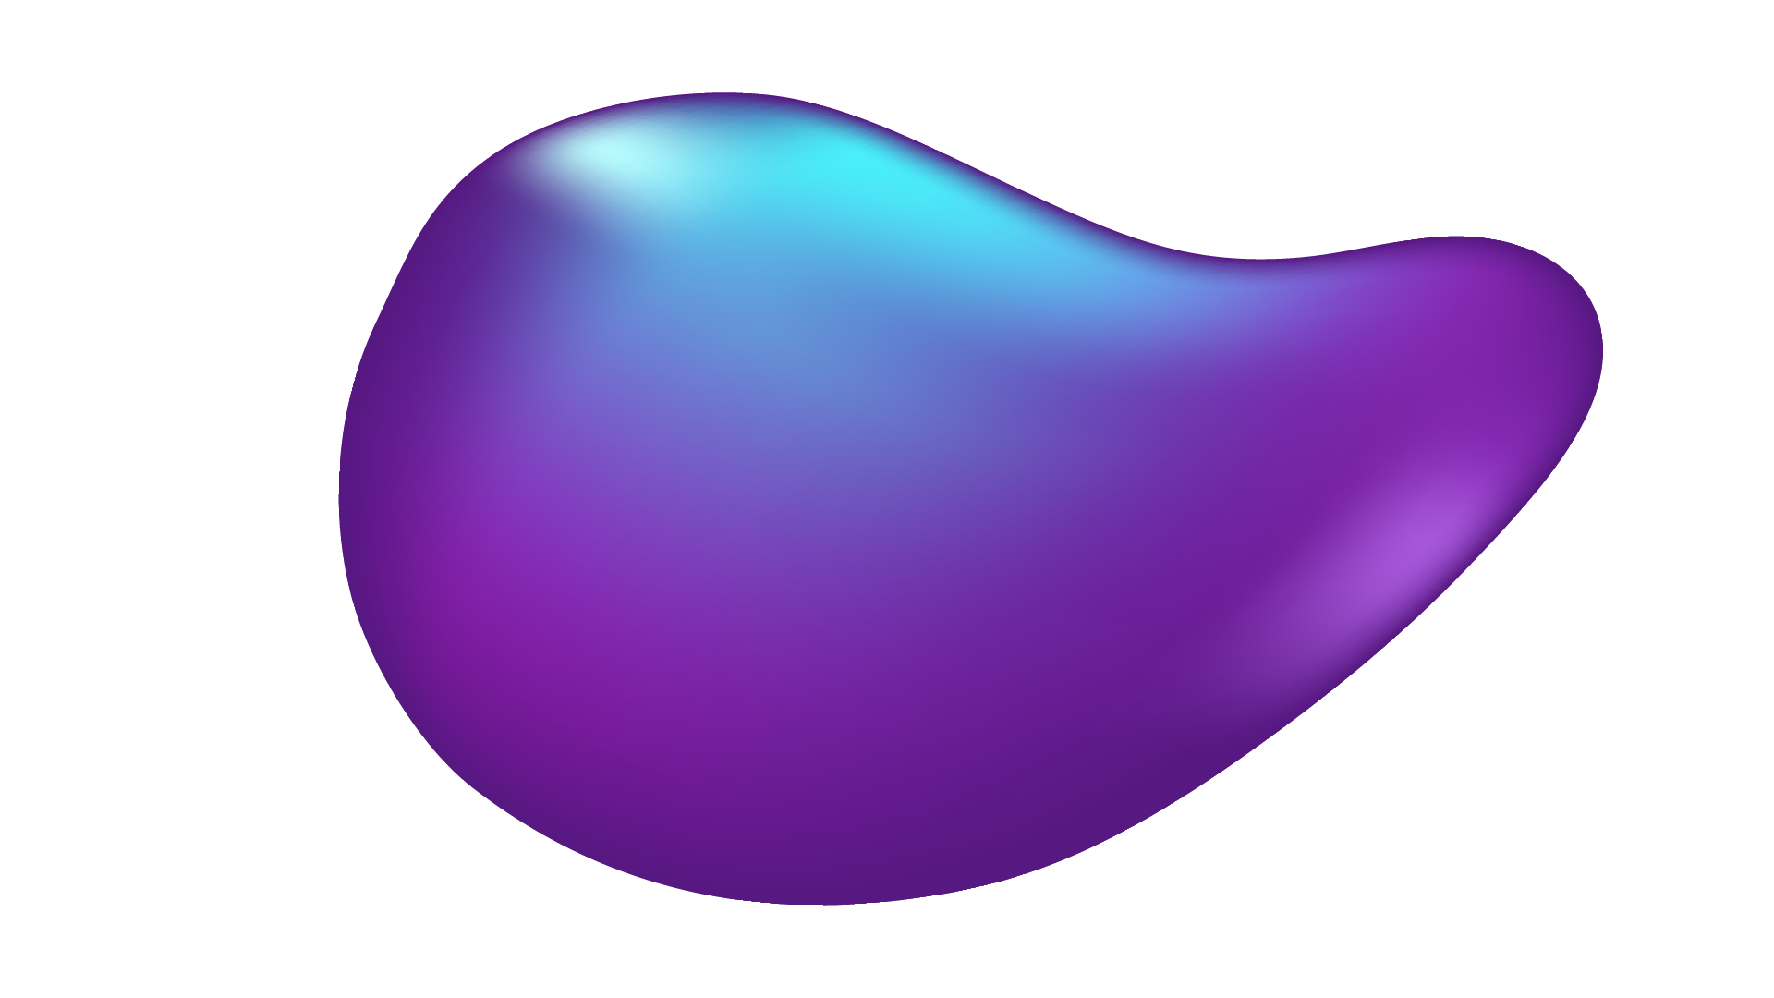

MLDAIP PROJECT
Automatic recognition of pancreatic tumors for CT images
Huszar Istvan Babinet Tudor
Sferle Andrei
Barba-Rosie George

Slide 2
TABLE OF CONTENTS
01
02
03
04
05
Project overview
ResNet50 (CNN)
DenseNet 201 (CNN)
EfficientNet_b0 (CNN)
Visual Transformer

Slide 3
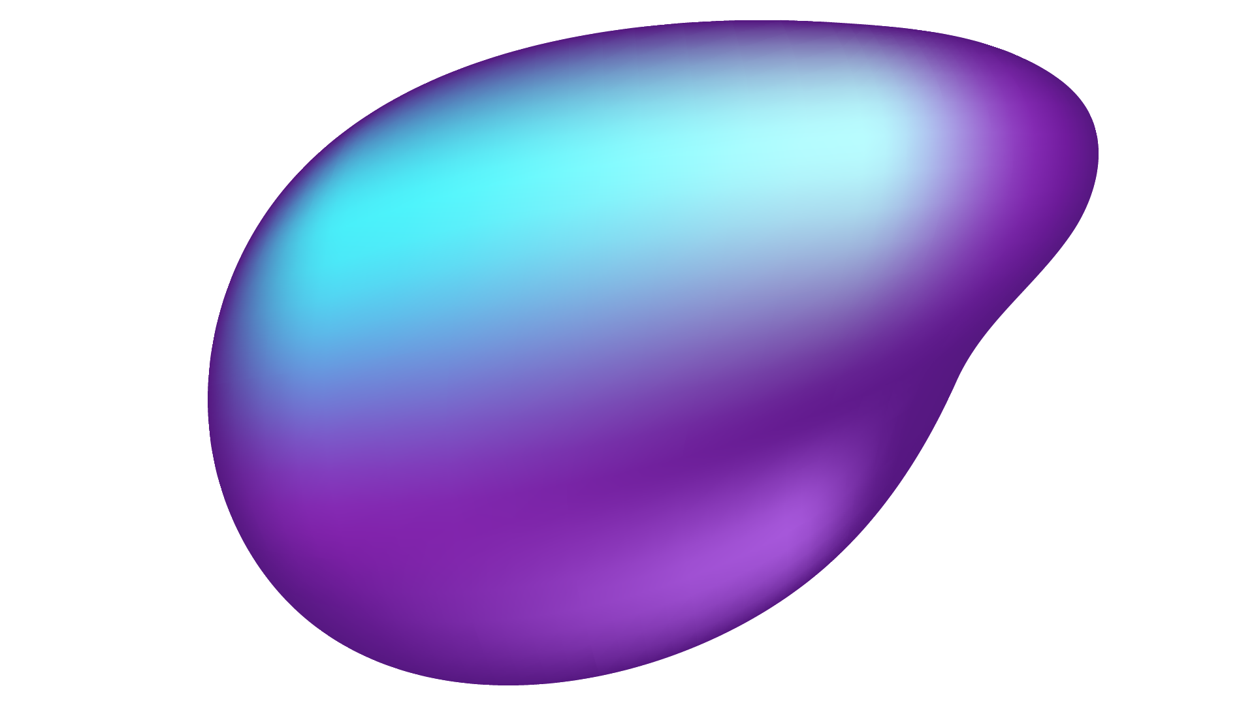

01
Project Overview
Notes:
The goal of the project was to compare different CNN models with visual transformers with the task of classification of CT images as pancreatic tumor or non pancreatic tumor.

Slide 4
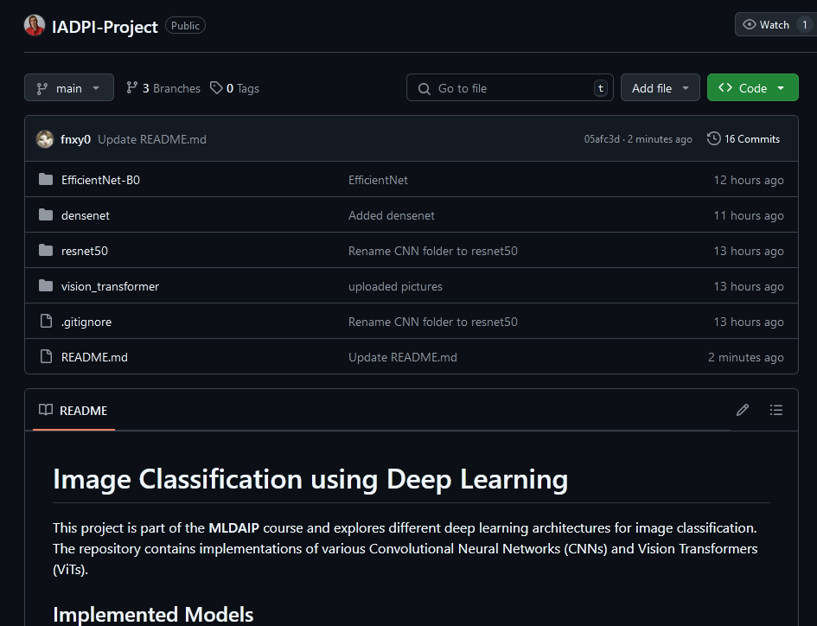
Project Overview - Version Control
Github repository used for version control and tracking changes.
https://github.com/xDeimen/IADPI-Project
Notes:
We used Git with and GitHub for version control. It allowed us to work better as a team for this project.

Slide 5



Project Overview - Main libraries used
Notes:
As main tools we used PyTorch compiled with cuda for faster training and gpu parallelization. After training we saved the model, and run inference on a test set and the results we got from the test set we introduced the into scikit learn to calculate our metrics.

Slide 6
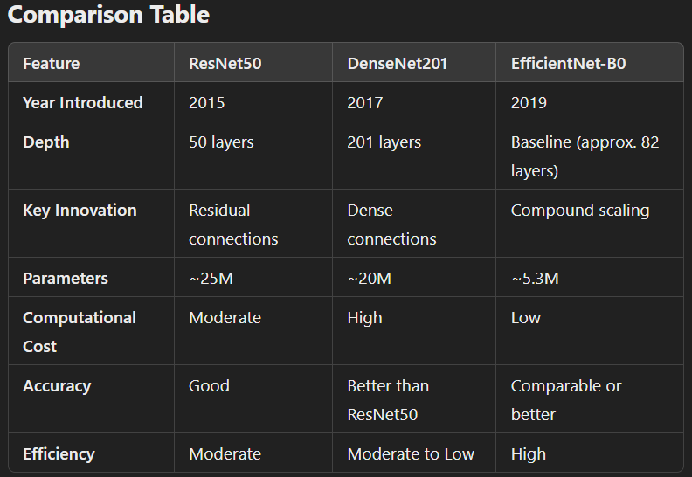
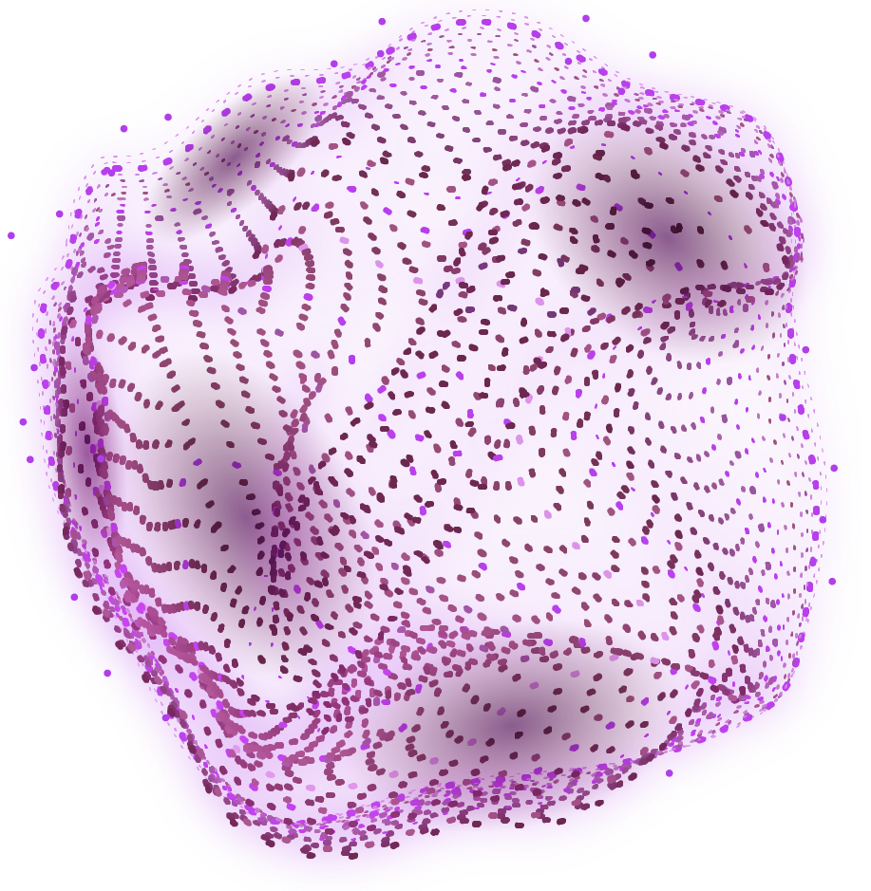
OUR COMPANY
Project Overview - CNN comparison
Notes:
This is a comparison between the CNN’s we tried:

Slide 7
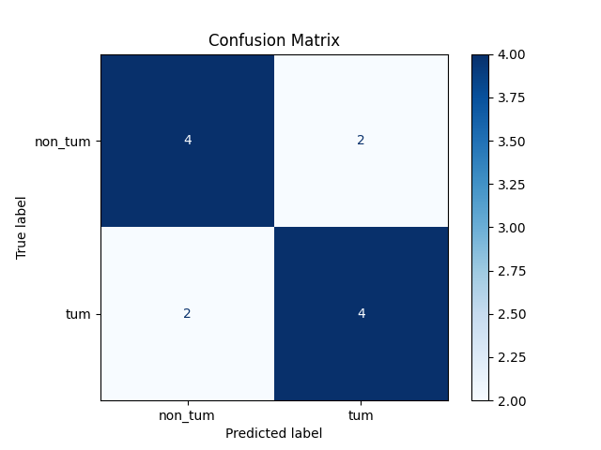
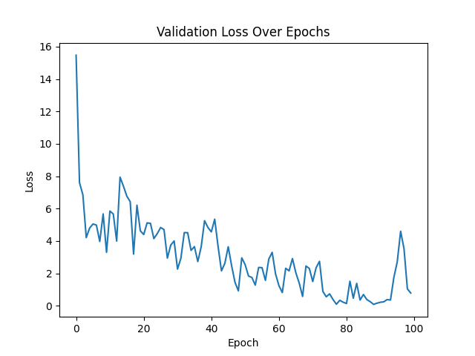
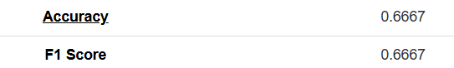
2. RESNET50
Notes:
These are the Results of the ResNet model. As you can see on the confusion matrix, it has a balanced outcome no biases, with some mis-predictions, but considering the size of the dataset and the size of the model this was the best Peforming CNN in our case (To be mentioned, the confusion matrix was calculated on data that the model has not seen before). On the right we have a graph with the validation loss during the training process, it has a descending trend which is a good thing, but considering it still has spikes the model is close to overfitting. We have 0.66 accuracy and 0.66 F1 Score.

Slide 8
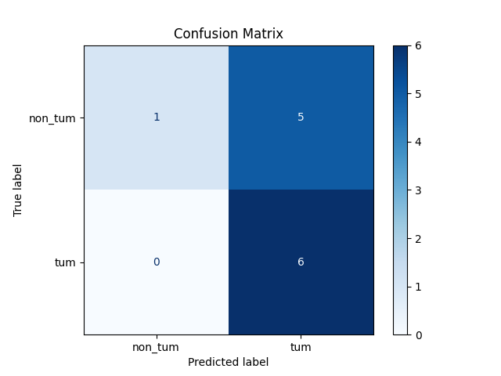
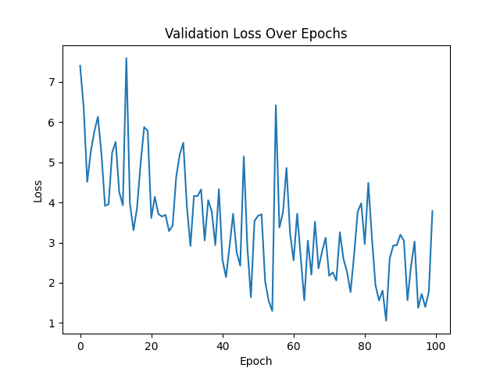
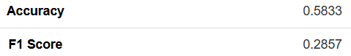
3. DENSENET201
Notes:
These are the Results of the DenseNet model. In the confusion matrix we have a clear bias towards pancreatic tumor, as the majority of non_tumors were classified as tumors. On the right, again the validation loss during the training process, still a descending trend, but now we can clearly see that this model is overfitted, instead of learning to generalize it memorized the dataset, which is completely understandable considering densenet has 201 layers, is a big model compared to the size of our dataset. We have 0.58 accuracy and 0.28 F1 Score from the bad recall.

Slide 9
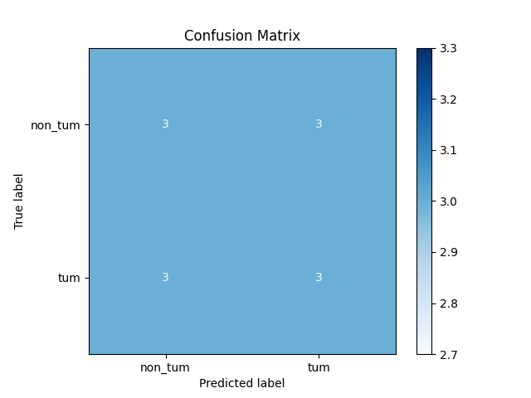
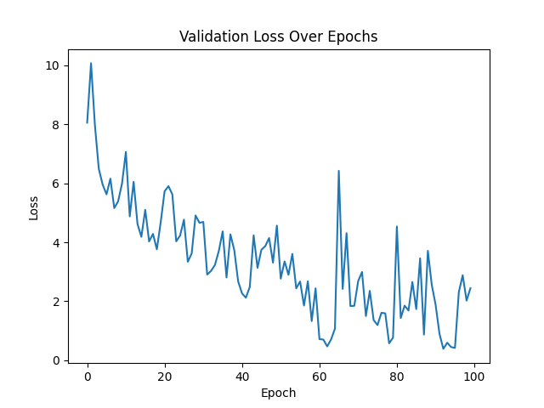
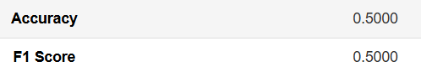
4. EFFICIENT NET B0
Notes:
These are the Results of the EfficientNet model. This is the most even confusion matrix we had, not a great look. It mis-predicts and predicts everything equally bad .For the validation loss we can see that the model is slowly overfitting, this was the second biggest model we tested with and again our data sample it is was not very favourable. We have 0.5 accuracy and 0.5 F1 Score.

Slide 10
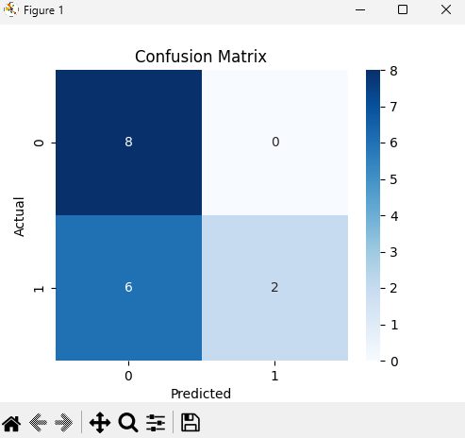
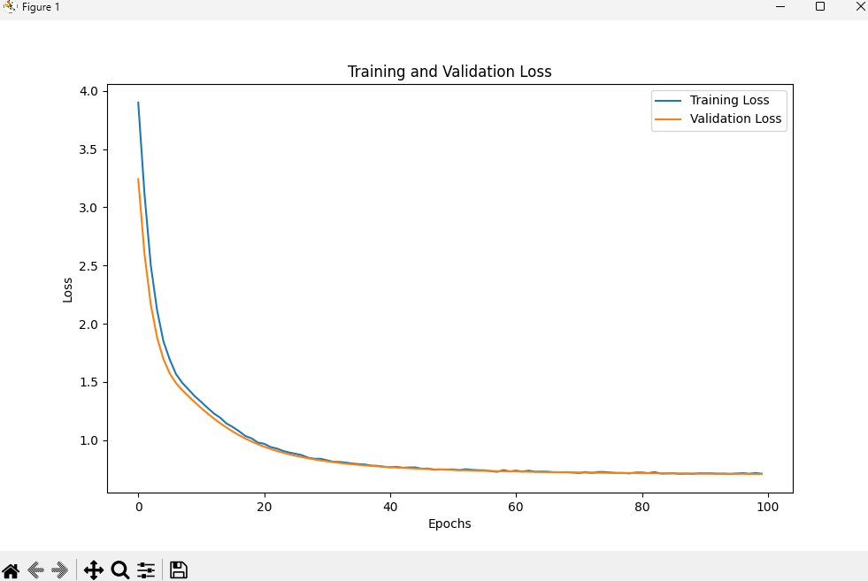
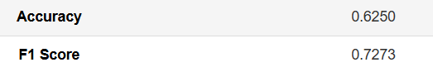
5. VISUAL TRANSFORMER
Notes:
Now for the visual transformer. As it can be seen, although there is a bias regarding non tumoral detections, this was the model with the cleanest Loss, with the least overfitting out of them all. Best accuracy was given by the ResNet50, while the best recall, F1 score, and Loss were given by the visual transformer.

Slide 11
THANKS!

